Slide 1
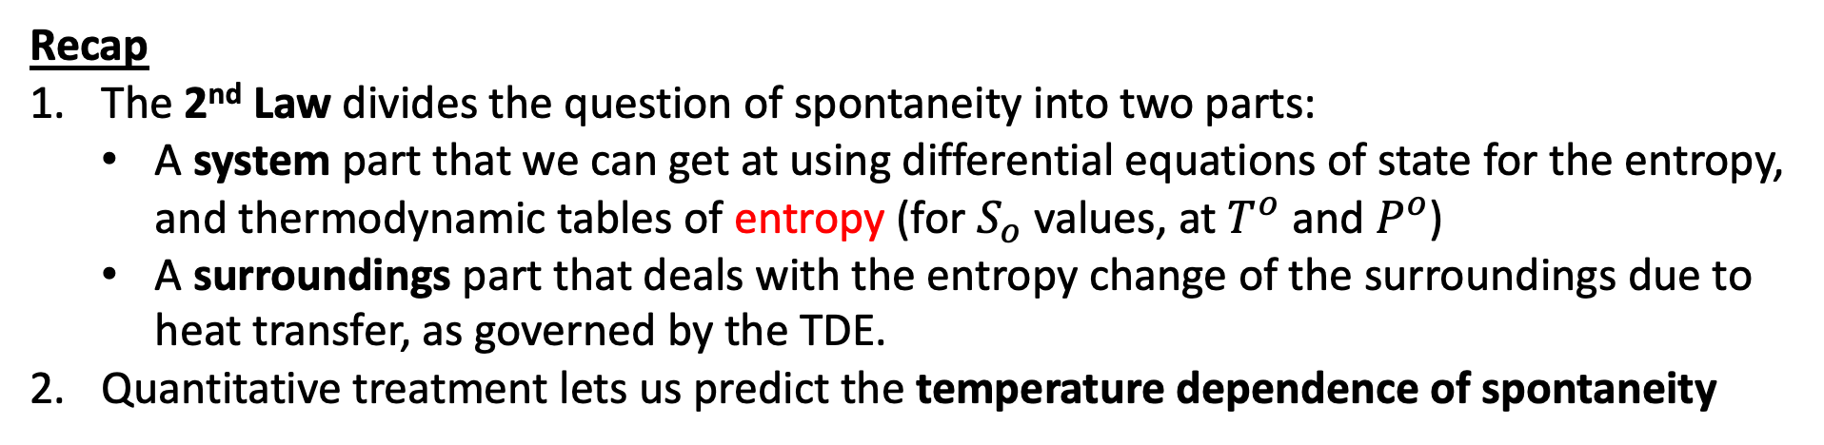
Scope of today’s work
Recap
The 2nd Law divides the question of spontaneity into two parts:
A system part that we can get at using differential equations of state for the entropy, and thermodynamic tables of entropy (for $S_{o}$ values, at $T^{o}$ and $P^{o}$)
A surroundings part that deals with the entropy change of the surroundings due to heat transfer, as governed by the TDE.
Quantitative treatment lets us predict the temperature dependence of spontaneity

Slide 2
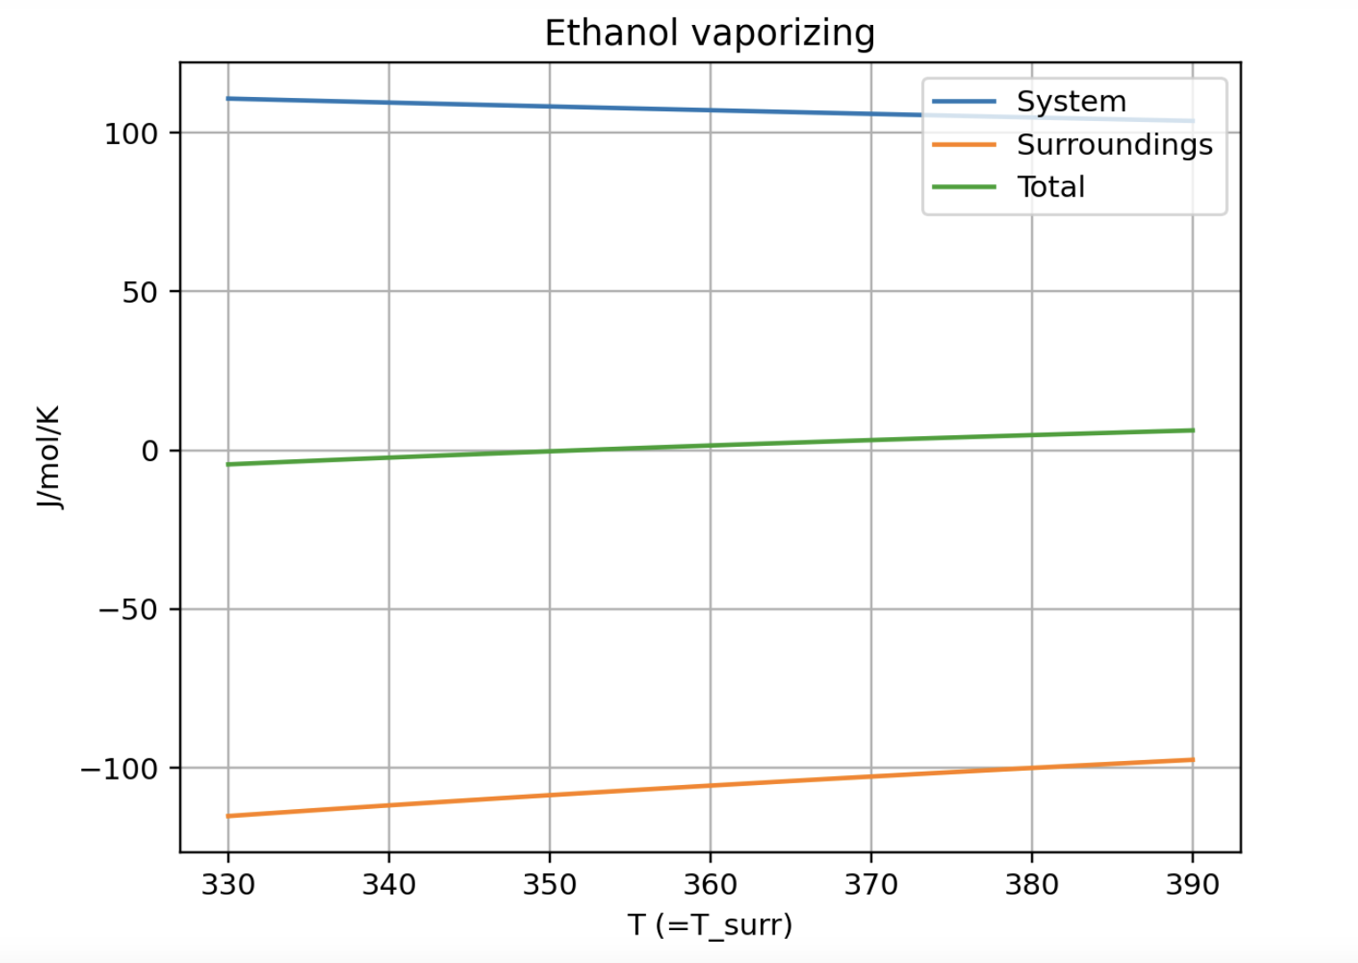
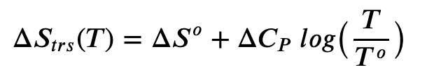

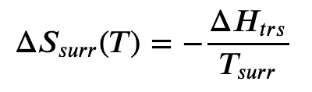
CGI: Week_11a.AnalyticalStot

Slide 3
Scope of today’s work
Next
Idea of reaction favorability (enthalpic and entropic)
Extension beyond phase transformations, to chemical reactions.

Slide 4
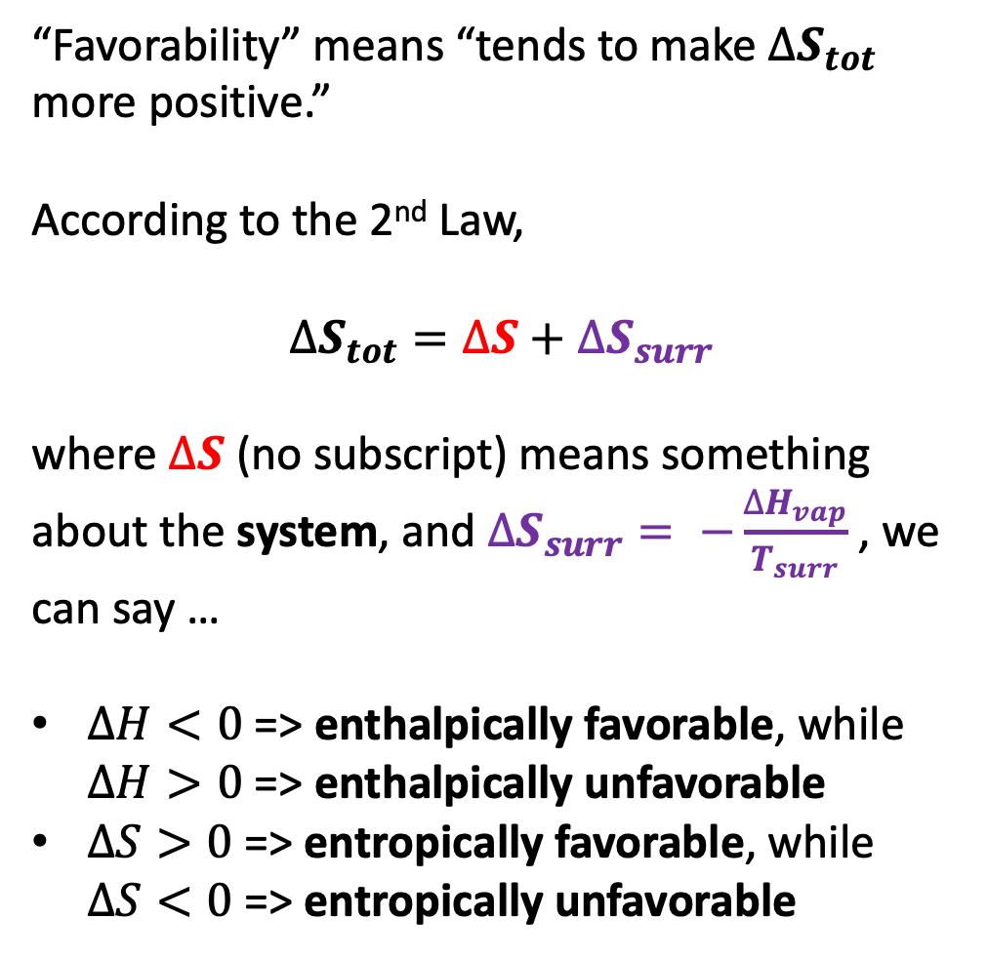
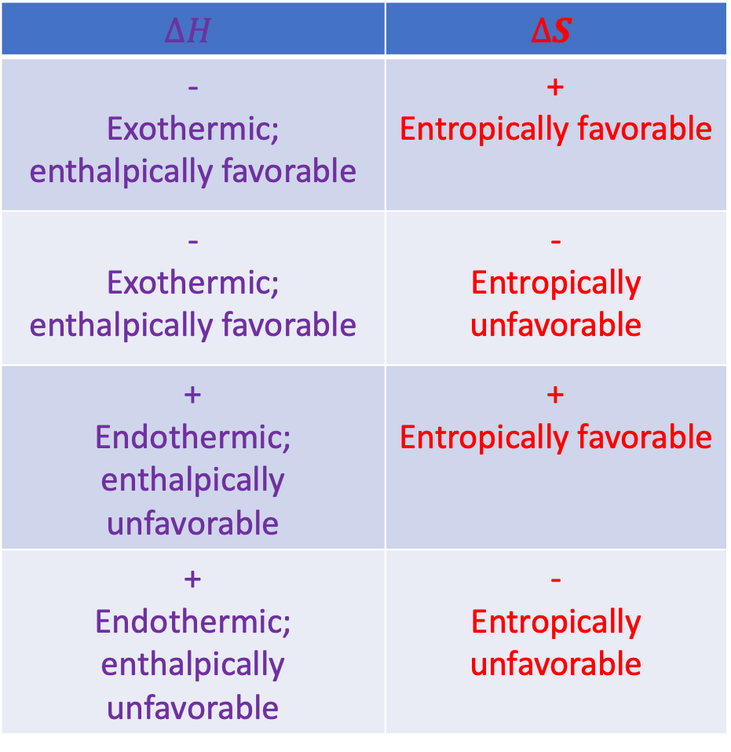
Reaction favorability and unfavorability
$$∆H$$ | $$∆S$$
- Exothermic; enthalpically favorable | + Entropically favorable
- Exothermic; enthalpically favorable | - Entropically unfavorable
+ Endothermic; enthalpically unfavorable | + Entropically favorable
+ Endothermic; enthalpically unfavorable | - Entropically unfavorable
“Favorability” means “tends to make $∆S_{tot}$ more positive.”
According to the 2nd Law,
$$∆S_{tot}=∆S+∆S_{surr}$$
where $∆S$ (no subscript) means something about the system, and $∆S_{surr}= −\frac{∆H_{vap}}{T_{surr}}$ , we can say …
$∆H<0$ => enthalpically favorable, while $∆H>0$ => enthalpically unfavorable
$∆S>0$ => entropically favorable, while $∆S<0$ => entropically unfavorable

Slide 5
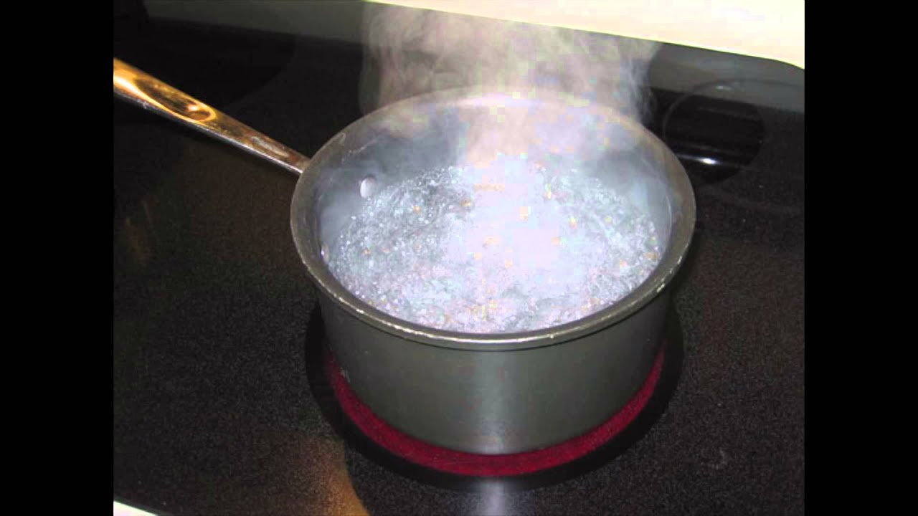

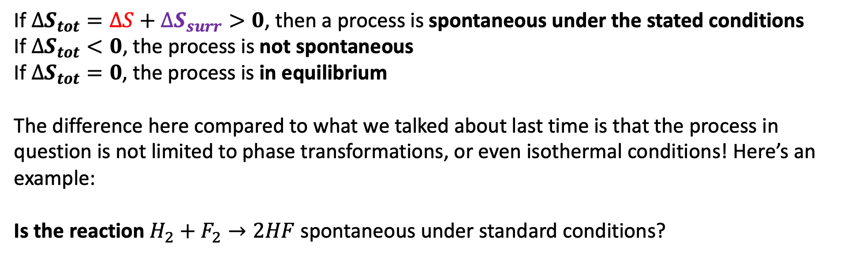
Beyond phase transformations: a general statement of the 2nd Law of thermodynamics
If $∆S_{tot}=∆S+∆S_{surr}>0$, then a process is spontaneous under the stated conditions
If $∆S_{tot}<0$, the process is not spontaneous
If $∆S_{tot}=0$, the process is in equilibrium
The difference here compared to what we talked about last time is that the process in question is not limited to phase transformations, or even isothermal conditions! Here’s an example:
Is the reaction $H_{2}+F_{2}→2HF$ spontaneous under standard conditions?
-$109$

Slide 6
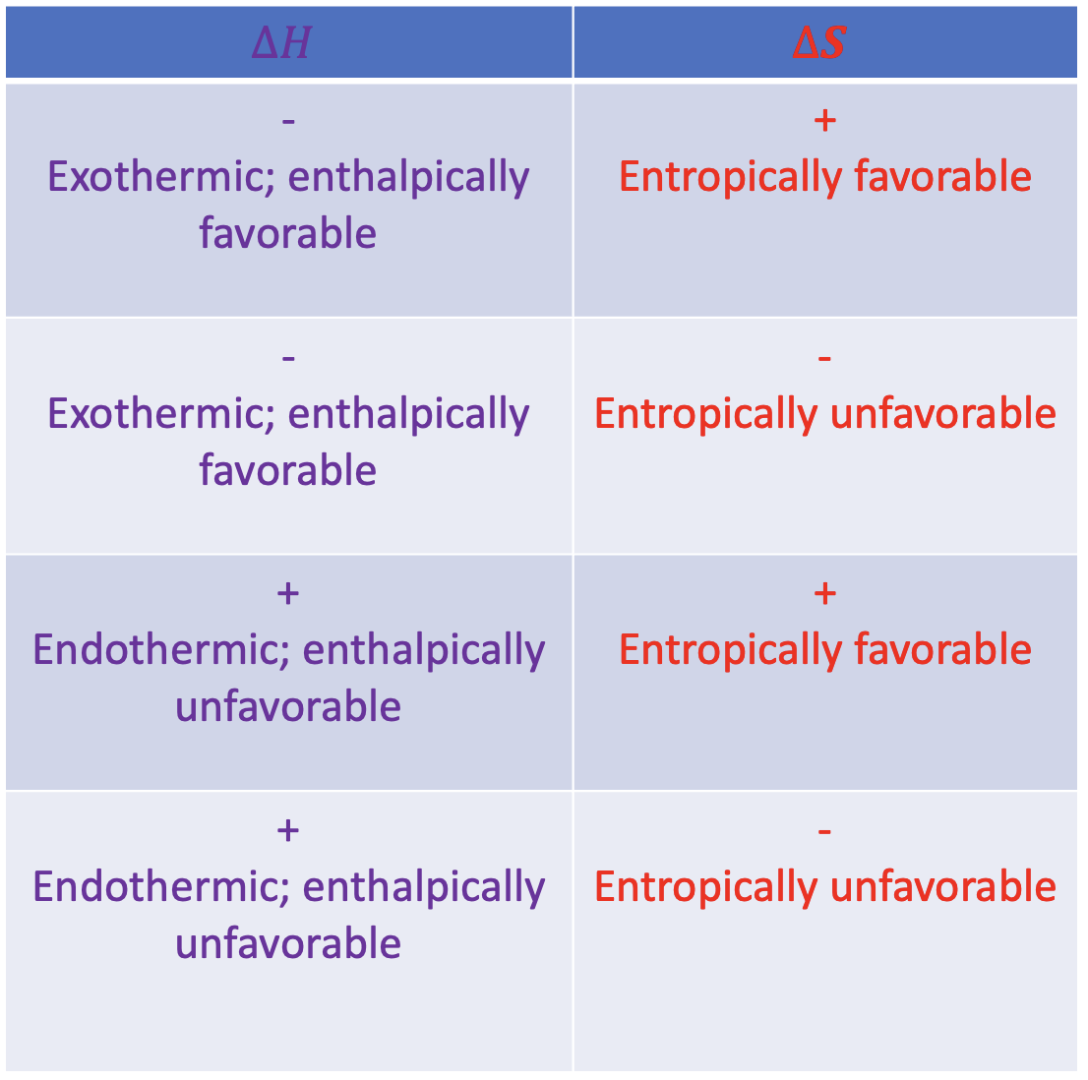
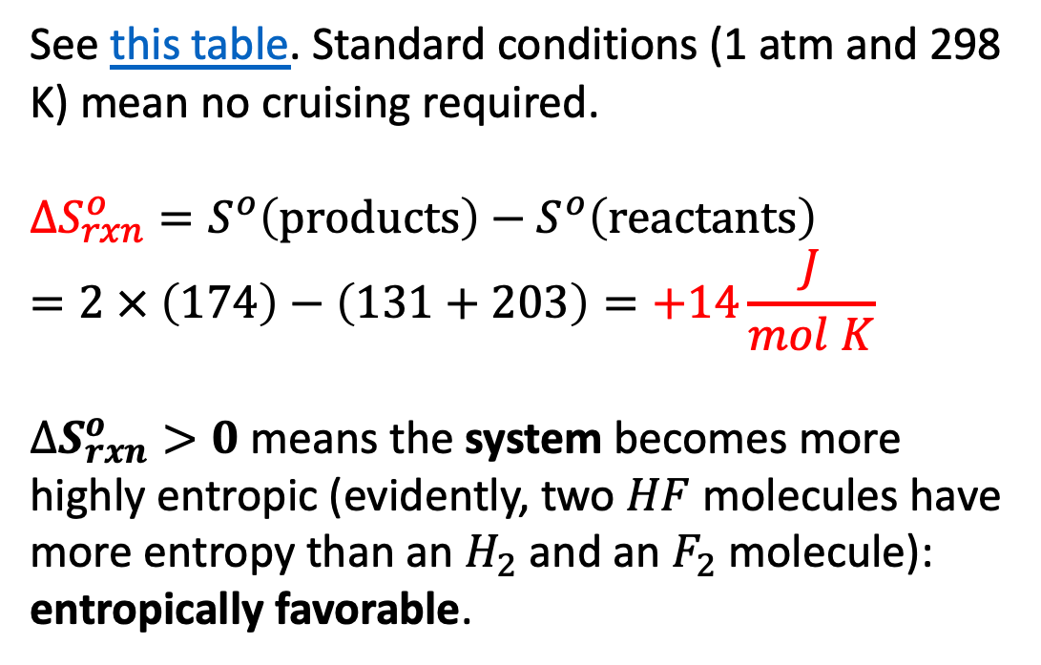
Thermodynamics of the reaction $H_{2}+F_{2}→2HF$
See this table. Standard conditions (1 atm and 298 K) mean no cruising required.
$$∆S_{rxn}^{o}=S^{o}\left(products\right)−S^{o}\left(reactants\right)=2 × \left(174\right)−\left(131+203\right)=+14\frac{J}{mol K}$$
$∆S_{rxn}^{o}>0$ means the system becomes more highly entropic (evidently, two $HF$ molecules have more entropy than an $H_{2}$ and an $F_{2}$ molecule): entropically favorable.

Slide 7
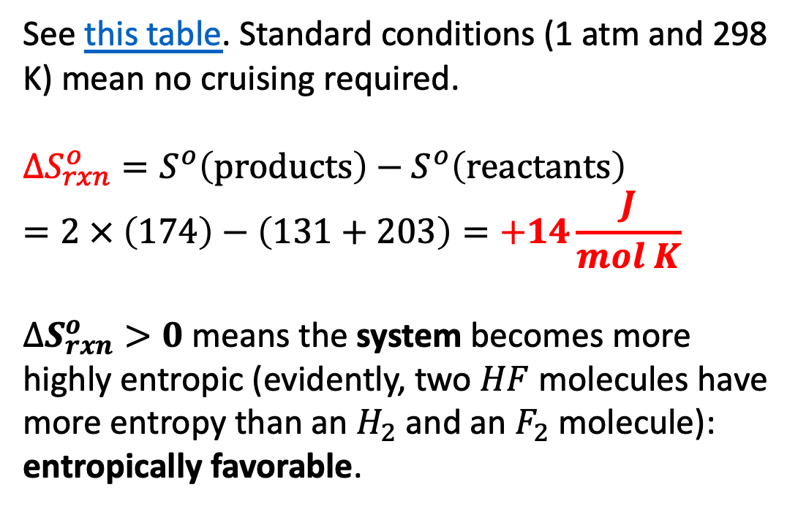

Thermodynamics of the reaction $H_{2}+F_{2}→2HF$
See this table. Standard conditions (1 atm and 298 K) mean no cruising required.
$$∆S_{rxn}^{o}=S^{o}\left(products\right)−S^{o}\left(reactants\right)=2 × \left(174\right)−\left(131+203\right)=+14\frac{J}{mol K}$$
$∆S_{rxn}^{o}>0$ means the system becomes more highly entropic (evidently, two $HF$ molecules have more entropy than an $H_{2}$ and an $F_{2}$ molecule): entropically favorable.
$$14\frac{J}{mol K}$$
$$14\frac{J}{mol K}$$

Slide 8
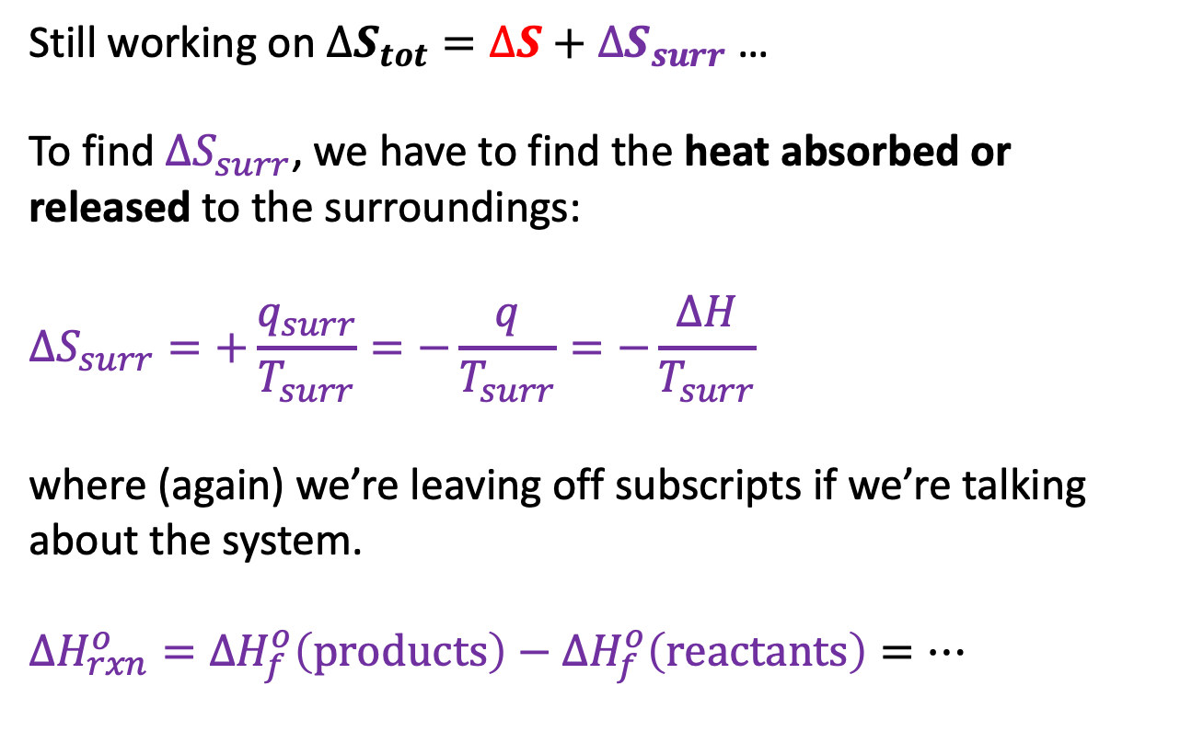
Thermodynamics of the reaction $H_{2}+F_{2}→2HF$
Still working on $∆S_{tot}=∆S+∆S_{surr}$ …
To find $∆S_{surr}$, we have to find the heat absorbed or released to the surroundings:
$$∆S_{surr}=+\frac{q_{surr}}{T_{surr}}=−\frac{q}{T_{surr}}=−\frac{∆H}{T_{surr}}$$
where (again) we’re leaving off subscripts if we’re talking about the system.
$∆H_{rxn}^{o}={∆H}_{f}^{o}\left(products\right)−{∆H}_{f}^{o}\left(reactants\right)=…$

Slide 9
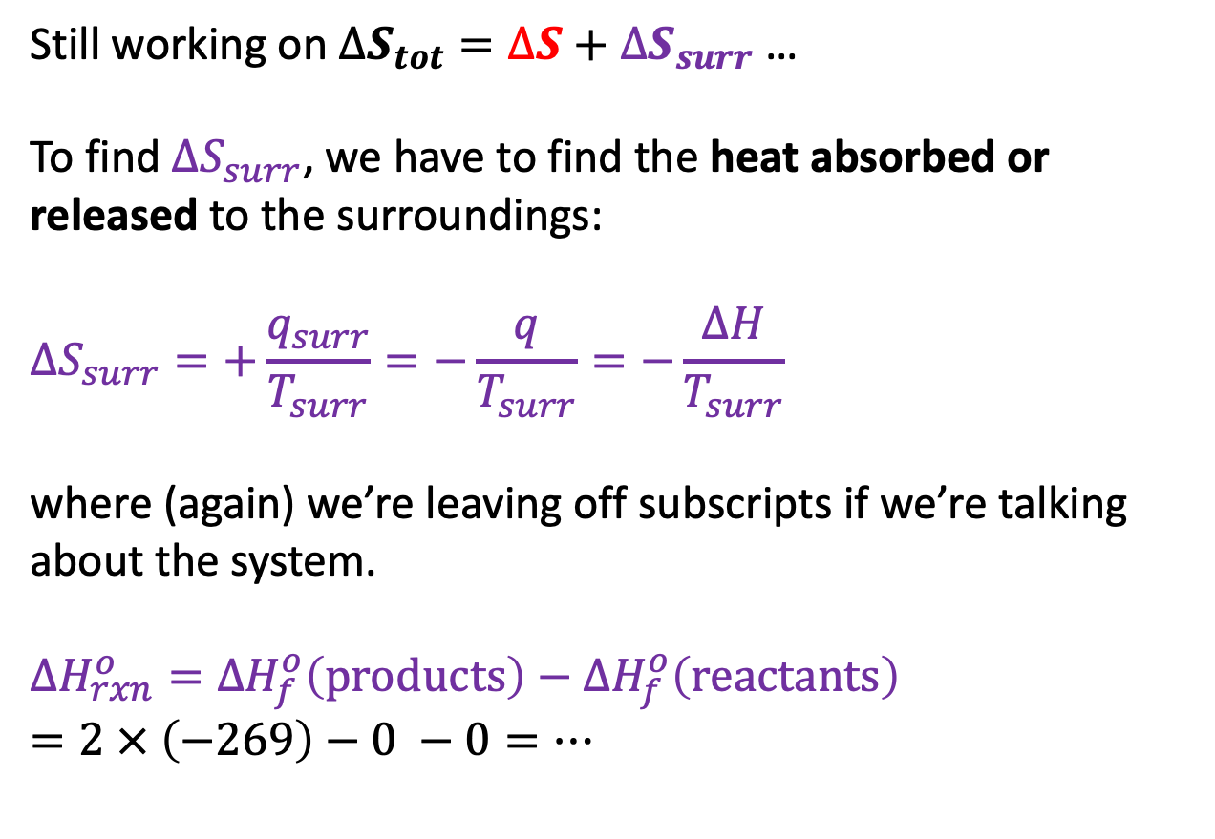
Thermodynamics of the reaction $H_{2}+F_{2}→2HF$
Still working on $∆S_{tot}=∆S+∆S_{surr}$ …
To find $∆S_{surr}$, we have to find the heat absorbed or released to the surroundings:
$$∆S_{surr}=+\frac{q_{surr}}{T_{surr}}=−\frac{q}{T_{surr}}=−\frac{∆H}{T_{surr}}$$
where (again) we’re leaving off subscripts if we’re talking about the system.
$∆H_{rxn}^{o}={∆H}_{f}^{o}\left(products\right)−{∆H}_{f}^{o}\left(reactants\right)$
$=2 × \left(−269\right)−0 −0=…$

Slide 10
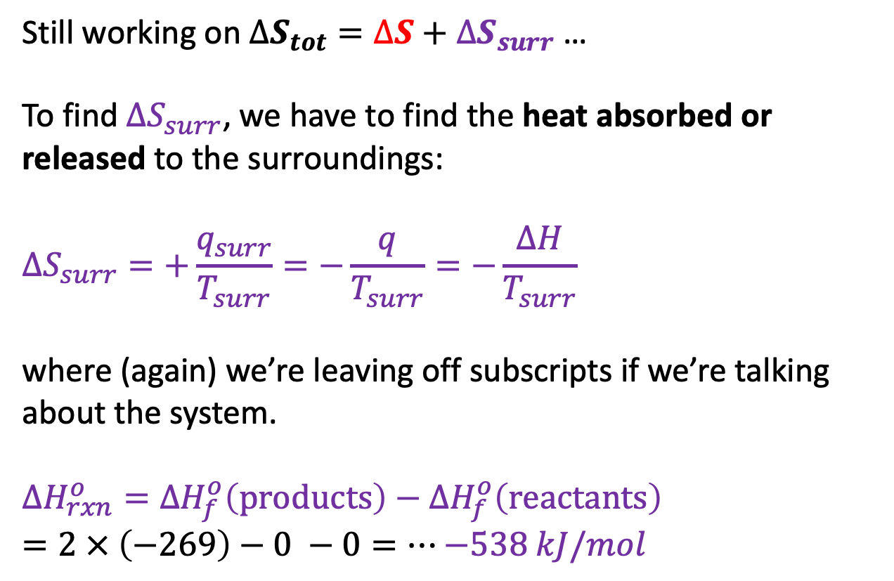
Thermodynamics of the reaction $H_{2}+F_{2}→2HF$
Still working on $∆S_{tot}=∆S+∆S_{surr}$ …
To find $∆S_{surr}$, we have to find the heat absorbed or released to the surroundings:
$$∆S_{surr}=+\frac{q_{surr}}{T_{surr}}=−\frac{q}{T_{surr}}=−\frac{∆H}{T_{surr}}$$
where (again) we’re leaving off subscripts if we’re talking about the system.
$∆H_{rxn}^{o}={∆H}_{f}^{o}\left(products\right)−{∆H}_{f}^{o}\left(reactants\right)$
$=2 × \left(−269\right)−0 −0=…$ $−538 kJ/mol$
$$14\frac{J}{mol K}$$

Slide 11
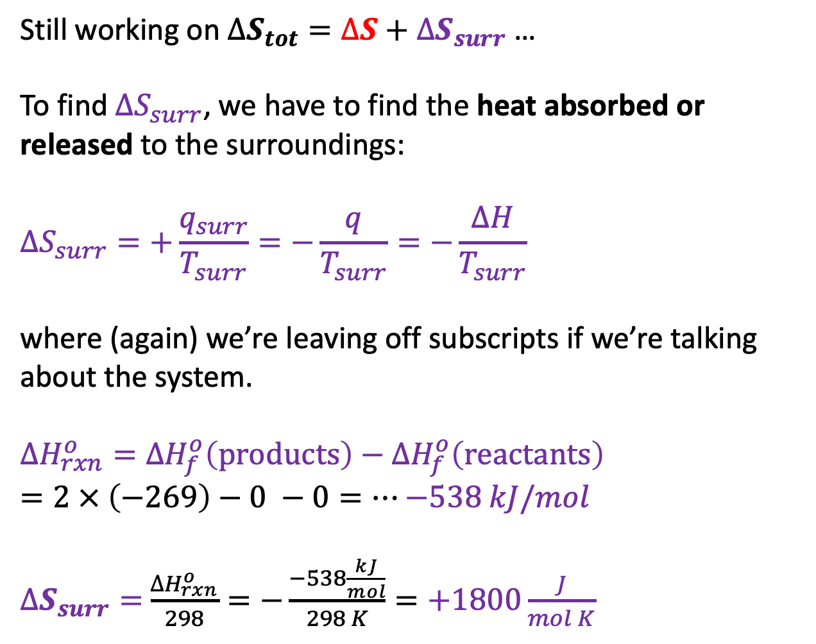

Thermodynamics of the reaction $H_{2}+F_{2}→2HF$
Still working on $∆S_{tot}=∆S+∆S_{surr}$ …
To find $∆S_{surr}$, we have to find the heat absorbed or released to the surroundings:
$$∆S_{surr}=+\frac{q_{surr}}{T_{surr}}=−\frac{q}{T_{surr}}=−\frac{∆H}{T_{surr}}$$
where (again) we’re leaving off subscripts if we’re talking about the system.
$∆H_{rxn}^{o}={∆H}_{f}^{o}\left(products\right)−{∆H}_{f}^{o}\left(reactants\right)$
$=2 × \left(−269\right)−0 −0=…$ $−538 kJ/mol$
$∆S_{surr}=$ $\frac{∆H_{rxn}^{o}}{298}=−\frac{−538\frac{kJ}{mol}}{298 K}=+1800\frac{J}{mol K}$
$$1800\frac{J}{mol K}$$
$$14\frac{J}{mol K}$$

Slide 12
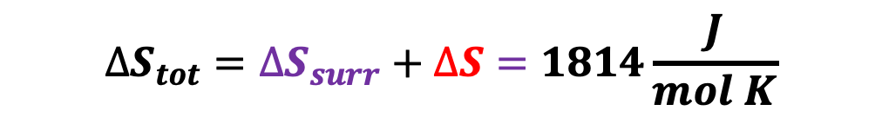
Thermodynamics of the reaction $H_{2}+F_{2}→2HF$
Still working on $∆S_{tot}=∆S+∆S_{surr}$ …
To find $∆S_{surr}$, we have to find the heat absorbed or released to the surroundings:
$$∆S_{surr}=+\frac{q_{surr}}{T_{surr}}=−\frac{q}{T_{surr}}=−\frac{∆H}{T_{surr}}$$
where (again) we’re leaving off subscripts if we’re talking about the system.
$∆H_{rxn}^{o}={∆H}_{f}^{o}\left(products\right)−{∆H}_{f}^{o}\left(reactants\right)$
$=2 × \left(−269\right)−0 −0=…$ $−538 kJ/mol$
$∆S_{surr}=$ $\frac{∆H_{rxn}^{o}}{298}=−\frac{−538\frac{kJ}{mol}}{298 K}=+1800\frac{J}{mol K}$
$$1800\frac{J}{mol K}$$
$$14\frac{J}{mol K}$$
$$∆S_{tot}=∆S_{surr}+∆S=1814\frac{J}{mol K}$$

Slide 13
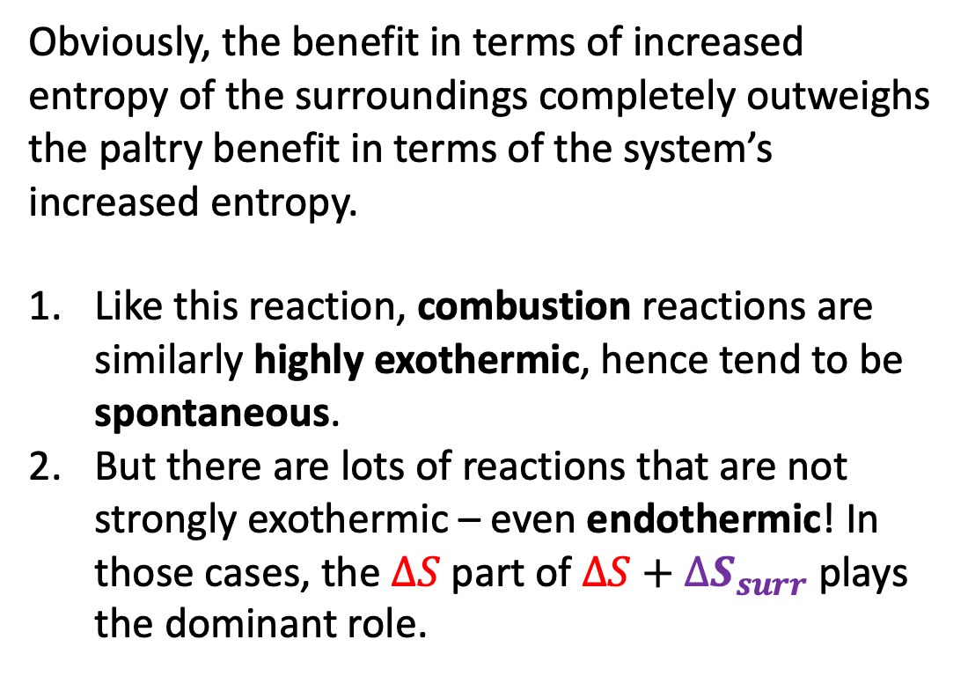
Thermodynamics of the reaction $H_{2}+F_{2}→2HF$
Obviously, the benefit in terms of increased entropy of the surroundings completely outweighs the paltry benefit in terms of the system’s increased entropy.
Like this reaction, combustion reactions are similarly highly exothermic, hence tend to be spontaneous.
But there are lots of reactions that are not strongly exothermic – even endothermic! In those cases, the $∆S$ part of $∆S+∆S_{surr}$ plays the dominant role.
$$1800\frac{J}{mol K}$$
$$14\frac{J}{mol K}$$
$$∆S_{tot}=∆S_{surr}+∆S=1814\frac{J}{mol K}$$

Slide 14
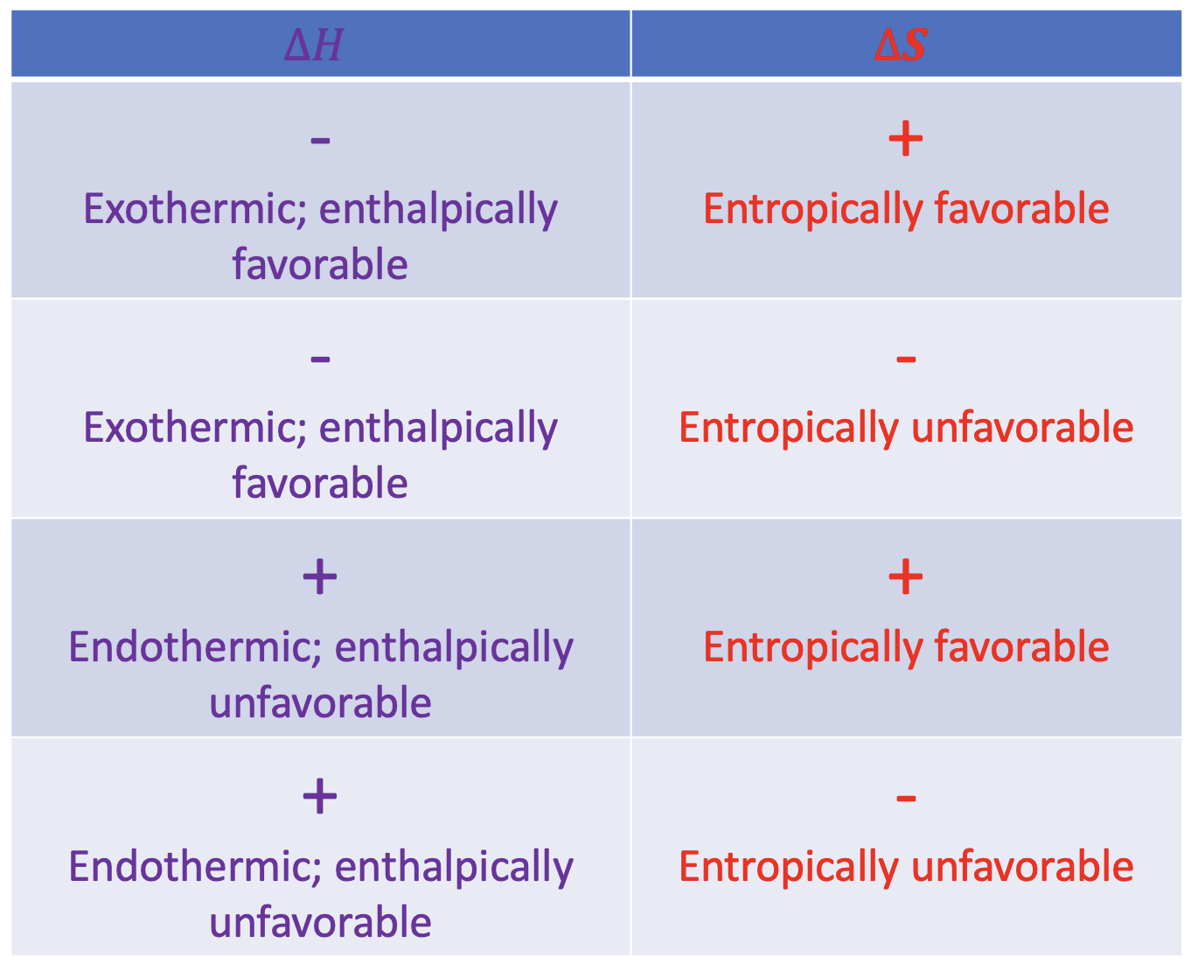
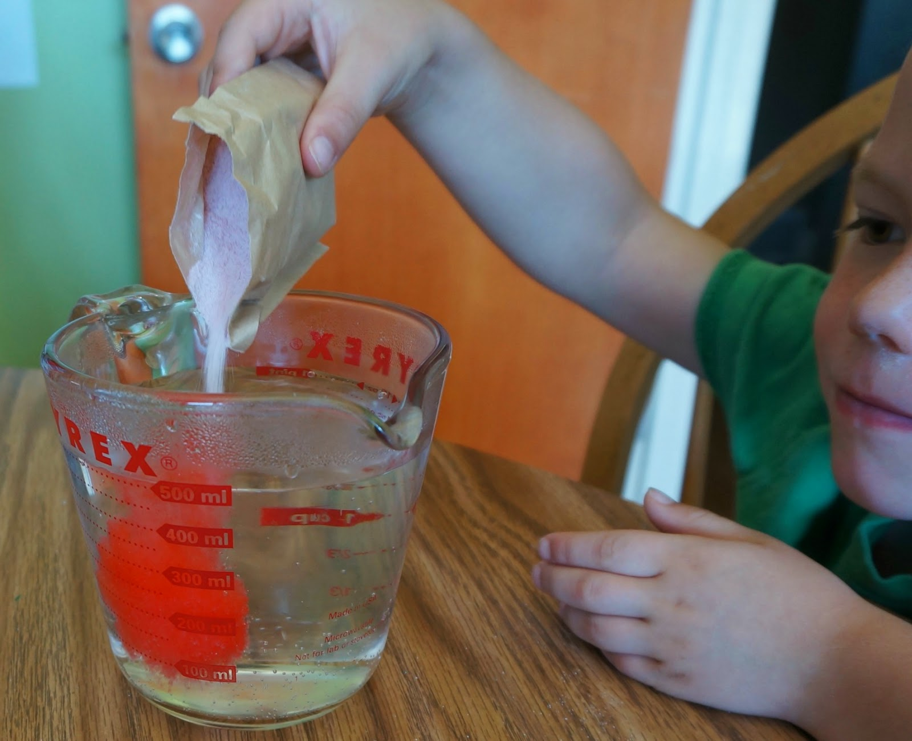










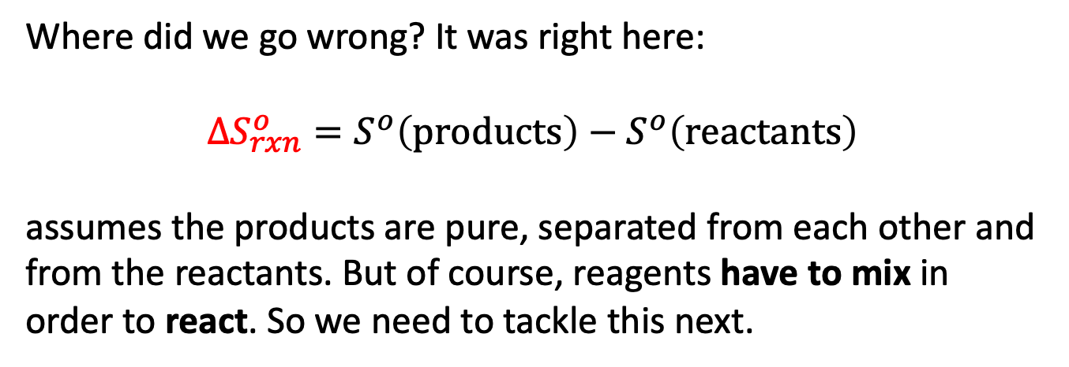


An important caveat for chemists: mixing
It turns out that this table omits something really critical. Remember we talked about irreversibility? Irreversibility happens whenever we mix different chemical substances.
Where did we go wrong? It was right here:
$$∆S_{rxn}^{o}=S^{o}\left(products\right)−S^{o}\left(reactants\right)$$
assumes the products are pure, separated from each other and from the reactants. But of course, reagents have to mix in order to react. So we need to tackle this next.
$H_{2}$
$H_{2}$
$H_{2}$
$H_{2}$
$$HF$$
$$F_{2}$$
$$F_{2}$$
$H_{2}$
$$HF$$
$$F_{2}$$
$$F_{2}$$
$$F_{2}$$
$$F_{2}$$

Slide 15
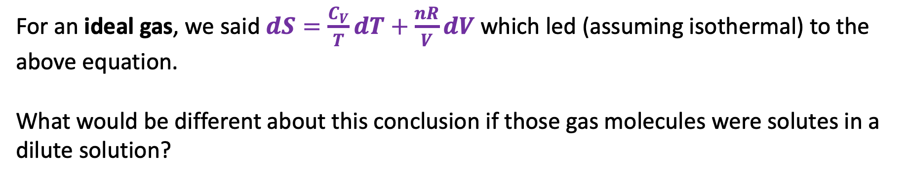
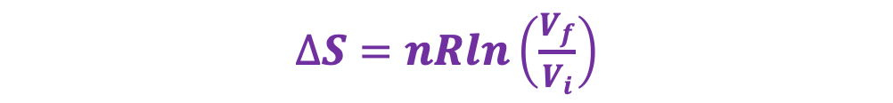
Taking a lesson from gases
$∆S=nRln\left(\frac{V_{f}}{V_{i}}\right)$
For an ideal gas, we said $dS=\frac{C_{V}}{T}dT+\frac{nR}{V}dV$ which led (assuming isothermal) to the above equation.
What would be different about this conclusion if those gas molecules were solutes in a dilute solution?

Slide 16
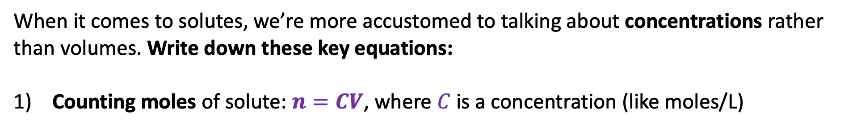
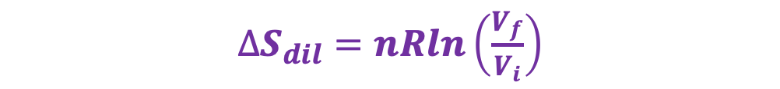
Entropy of dilution
$∆S_{dil}=nRln\left(\frac{V_{f}}{V_{i}}\right)$
When it comes to solutes, we’re more accustomed to talking about concentrations rather than volumes. Write down these key equations:
Counting moles of solute: $n=CV$, where $C$ is a concentration (like moles/L)

Slide 17
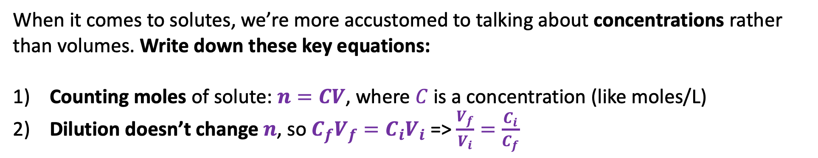
Entropy of dilution
$∆S_{dil}=nRln\left(\frac{V_{f}}{V_{i}}\right)$
When it comes to solutes, we’re more accustomed to talking about concentrations rather than volumes. Write down these key equations:
Counting moles of solute: $n=CV$, where $C$ is a concentration (like moles/L)
Dilution doesn’t change $n$, so $C_{f}V_{f}={C_{i}V}_{i}$ => $\frac{V_{f}}{V_{i}}=\frac{C_{i}}{C_{f}}$

Slide 18
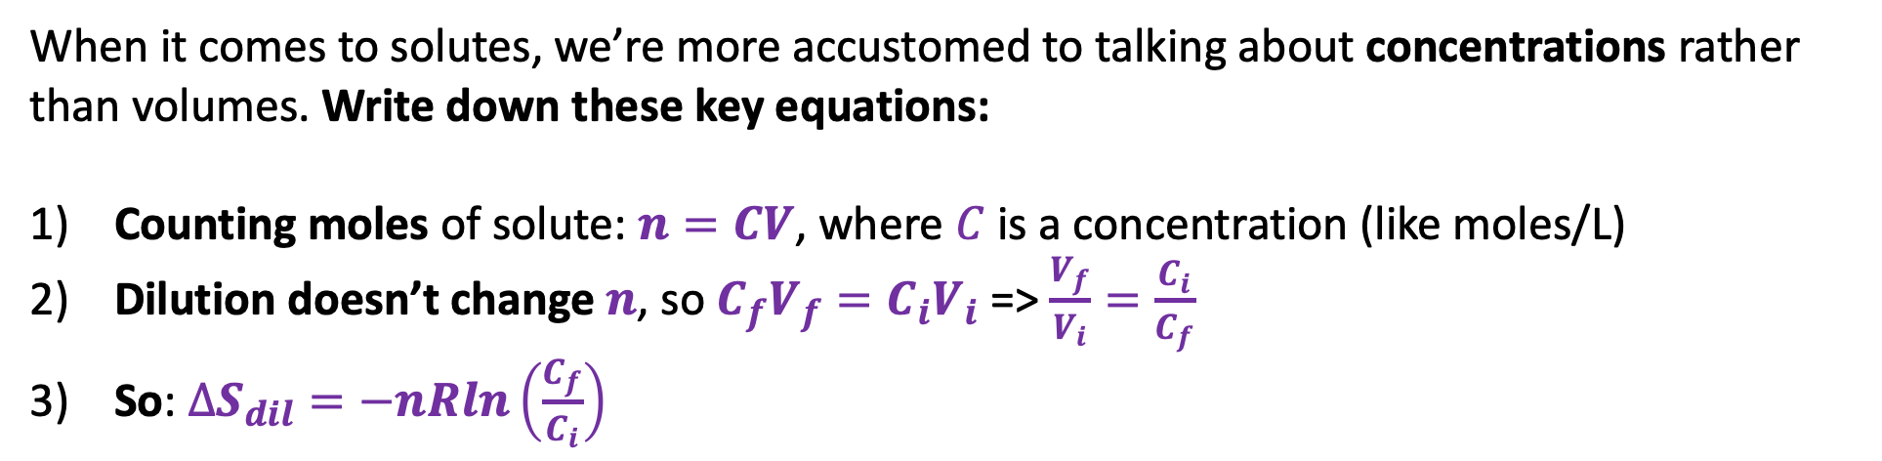
Entropy of dilution
$∆S_{dil}=nRln\left(\frac{V_{f}}{V_{i}}\right)$
When it comes to solutes, we’re more accustomed to talking about concentrations rather than volumes. Write down these key equations:
Counting moles of solute: $n=CV$, where $C$ is a concentration (like moles/L)
Dilution doesn’t change $n$, so $C_{f}V_{f}={C_{i}V}_{i}$ => $\frac{V_{f}}{V_{i}}=\frac{C_{i}}{C_{f}}$
So: $∆S_{dil}=−nRln\left(\frac{C_{f}}{C_{i}}\right)$

Slide 19
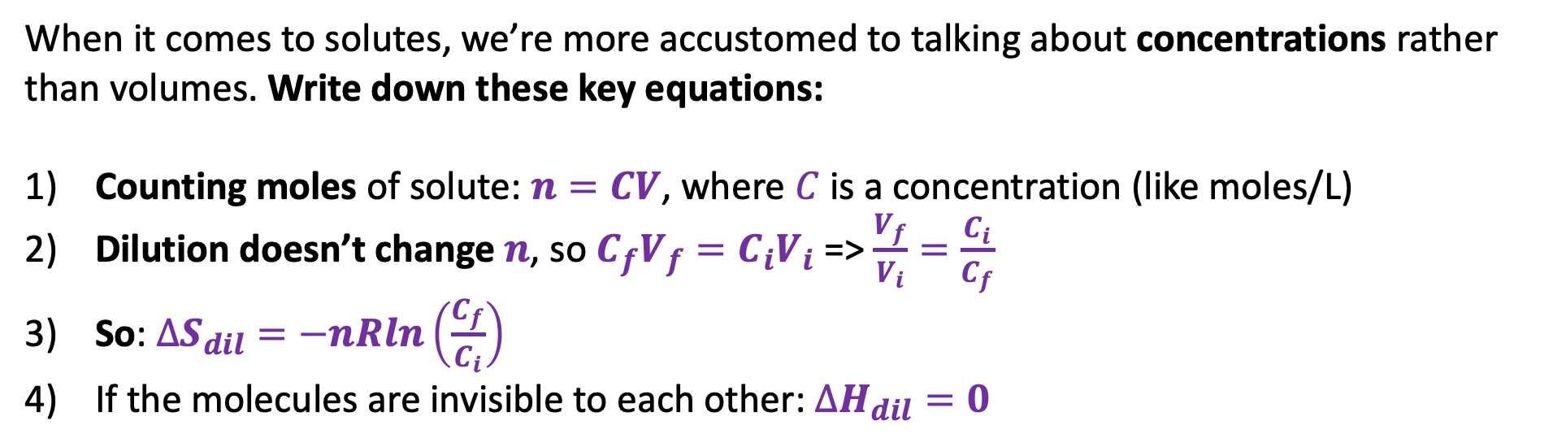
Entropy of dilution
$∆S_{dil}=nRln\left(\frac{V_{f}}{V_{i}}\right)$
When it comes to solutes, we’re more accustomed to talking about concentrations rather than volumes. Write down these key equations:
Counting moles of solute: $n=CV$, where $C$ is a concentration (like moles/L)
Dilution doesn’t change $n$, so $C_{f}V_{f}={C_{i}V}_{i}$ => $\frac{V_{f}}{V_{i}}=\frac{C_{i}}{C_{f}}$
So: $∆S_{dil}=−nRln\left(\frac{C_{f}}{C_{i}}\right)$
If the molecules are invisible to each other: $∆H_{dil}=0$

Slide 20
Entropy of dilution
$∆S_{dil}=nRln\left(\frac{V_{f}}{V_{i}}\right)$
When it comes to solutes, we’re more accustomed to talking about concentrations rather than volumes. Write down these key equations:
Counting moles of solute: $n=CV$, where $C$ is a concentration (like moles/L)
Dilution doesn’t change $n$, so $C_{f}V_{f}={C_{i}V}_{i}$ => $\frac{V_{f}}{V_{i}}=\frac{C_{i}}{C_{f}}$
So: $∆S_{dil}=−nRln\left(\frac{C_{f}}{C_{i}}\right)$
If the molecules are invisible to each other: $∆H_{dil}=0$
These formulas define what we call an “ideal solution”

Slide 21
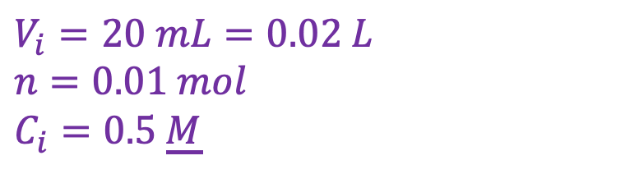
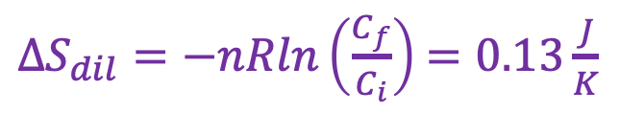
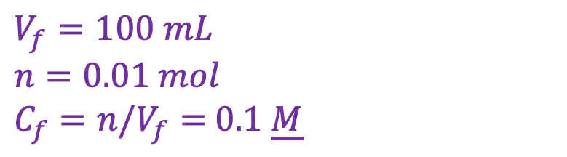
Example of entropy of dilution (CGI) …
$$V_{i}=20 mL=0.02 L$$
$$n=0.01 mol$$
$$C_{i}=0.5 \underline{M}$$
$$V_{f}=100 mL$$
$n=0.01 mol$
$C_{f}=n/V_{f}=$ $0.1$ $\underline{M}$
$∆S_{dil}=−nRln\left(\frac{C_{f}}{C_{i}}\right)$ $=0.13\frac{J}{K}$

Slide 22
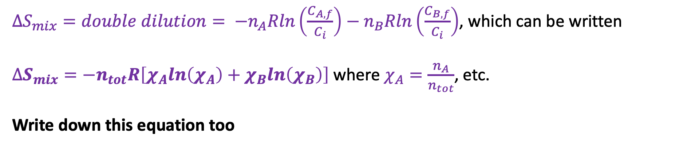

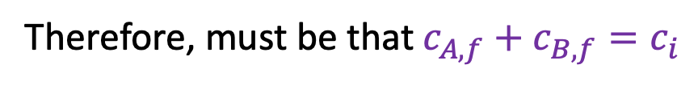



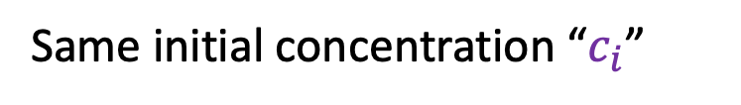
Entropy of mixing
$$n_{A}$$
$$c_{B,f}$$
$$n_{B}$$
$$c_{A,f}$$
Same initial concentration “$c_{i}$”
Therefore, must be that $c_{A,f}+c_{B,f}=c_{i}$
$∆S_{mix}=double dilution= −n_{A}Rln\left(\frac{C_{A,f}}{C_{i}}\right)−n_{B}Rln\left(\frac{C_{B,f}}{C_{i}}\right)$, which can be written
$∆S_{mix}=−n_{tot}R\left[χ_{A}ln\left(χ_{A}\right)+χ_{B}ln\left(χ_{B}\right)\right]$ where $χ_{A}=\frac{n_{A}}{n_{tot}}$, etc.
Write down this equation too

Slide 23
Example of entropy of mixing
$$∆S_{mix}=−n_{tot}R\left[χ_{A}ln\left(χ_{A}\right)+χ_{B}ln\left(χ_{B}\right)\right]$$
10 mL of A and 20 mL of B
(both 1 M solutions)
Let mix
B
A

Slide 24
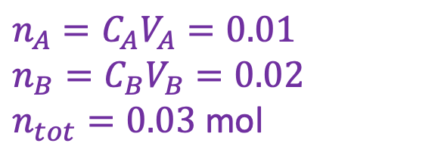
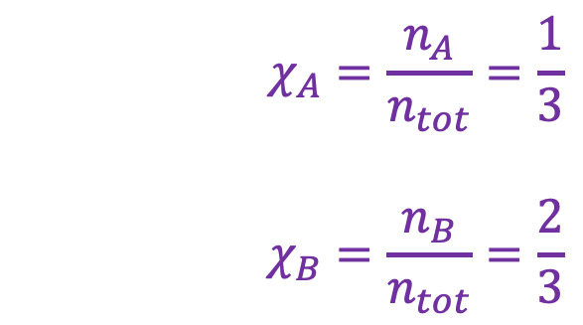
Example of entropy of mixing
$$∆S_{mix}=−n_{tot}R\left[χ_{A}ln\left(χ_{A}\right)+χ_{B}ln\left(χ_{B}\right)\right]$$
10 mL of A and 20 mL of B
(both 1 M solutions)
$$χ_{A}=\frac{n_{A}}{n_{tot}}=\frac{1}{3}$$
$$χ_{B}=\frac{n_{B}}{n_{tot}}=\frac{2}{3}$$
Let mix
B
A
$$n_{A}=C_{A}V_{A}=0.01$$
$$n_{B}=C_{B}V_{B}=0.02$$
$n_{tot}=0.03$ mol
$$∆S_{mix}=−0.03 R\left[\frac{1}{3} ln\left(\frac{1}{3}\right)+\frac{2}{3}ln\left(\frac{2}{3}\right)\right]≈+0.2\frac{J}{mol K}$$

Slide 25
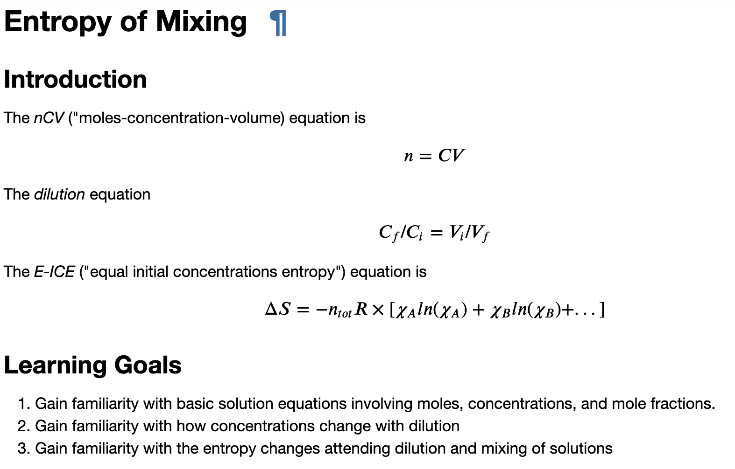
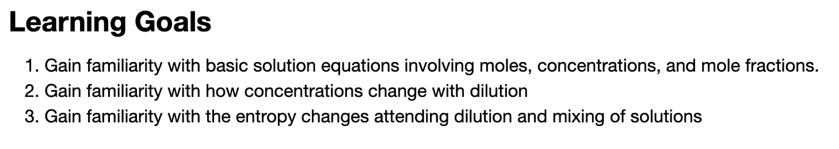
CGI: Week_11b.EntropyOfMixing
A
B
A
B
A
B

Slide 26




CGI: Week_11b.EntropyOfMixing
A
B
A
B
A
B
$${∆S}_{mix}$$
$$0$$
$$χ_{A}$$
$$1$$

